Slide 1

Instructional Design and the Practice of Coaching
Quick Participant Intros
Name and location
If someone described my coaching style, they would say I am…..
Matthew Ellis, Manager
Talent Management and Organizational Development
Notes:
My quick intro
Quick intro of participants
FRS disclaimer
Have a dialog today. Share top of mind thoughts, ask challenging questions, and go with your gut abut the content I’m sharing today
I may call on you directly. That is simply to get those top of mind thoughts and keep you engaged. Certainly not to put you on the spot.
You can pass if you like with no harm done.
Set Participant Expectations
Anything you want to discuss today to determine if I can provide that or point you in the right direction
Any expectations today that would make this a valuable session for you?

Slide 2

Today’s Learning Outcomes
By the end of our session, you will be familiar with basic instructional design and adult learning theory to help you design resources that market your coaching practice and build your coaching brand
Notes:
Today’s Learning Outcomes
By the end of our session, you will be familiar with basic instructional design and adult learning theory to help you design resources that market your coaching practice and build your coaching brand

Slide 3
Adult Learning Theory and Its Impact on
Marketing to Potential Clients
Adults have life and professional experiences to draw from.
Adult learners are informed by their experiences. This makes for a biased perspective on all learning.
Their biases towards the content you present can be positive, open and welcoming or negative and cautious/critical.
Adults will transform what they learn and make it their own. They won’t duplicate your approach or content exactly.
Adults value utility. Adults desire useful tools to solve problems. They also value clear and concise instruction and explanations.
Adults like flexibility and choices of how to learn. It gives them a sense of control. They are usually the boss.
If adults have time, they will explore. Otherwise, they are most often trying to fix a problem and need to best tool that is easiest to learn.
Notes:
Adult Learning Theory and Its Impact on Marketing to Potential Clients
Adults have life and professional experiences to draw from.
Adult learners are informed by their experiences. This makes for a biased perspective on all learning.
Their biases towards the content you present can be positive, open and welcoming or negative and cautious/critical.
Ask in Chat: (responses in discussion or in chat) What could be some biases potential clients might have towards coaching or your coaching methodology, in particular?
Adults will transform what they learn and make it their own. They won’t duplicate your approach or content exactly.
Adults value utility. Adults desire useful tools to solve problems. They also value clear and concise instruction and explanations.
Ask in Chat: What is one piece of content from your coaching approach that is a tool to solve a problem for your clients?
Adults like flexibility and choices of how to learn. It gives them a sense of control. They are usually the boss.
If adults have time, they will explore. Otherwise, they are most often trying to fix a problem and need to best tool that is easiest to learn.
Ask in Chat: What feedback have you gotten from your clients that your coaching methods or tools are easy to use or apply in their lives?
Transition: What key takeaways do you have from these adult learning principles when you thin about attracting clients? Here’s one more key takeaway I want for each of you…(say each person’s name)

Slide 4


Adult Learning Theory and Its Impact on
Marketing to Potential Clients
Key Takeaway: Identify the strengths, unique services, or areas of expertise in your coaching methods that will take your clients where they want to go.
Sell the sizzle of your coaching methodology!!
Sell what makes you unique!
Notes:
Adult Learning Theory and Its Impact on Marketing to Potential Clients
Key Takeaway: Identify the strengths, unique services, or areas of expertise in your coaching methods that will meet a potential client where they are?
Steak on grill: See the sizzle of your coaching methodology!!
Reveal: vegan barbecue with grilled veggies
Ask: What is the sizzle for your coaching practice? How can your coaching techniques serve your client? Why would someone want to be coached by you?
Transition: Now that you have them interested, how will you engage your clients as learners. Use proven learning strategies.
Next slide

Slide 5
Learning Strategies to Engage Clients
These strategies can be part of your brand!
Consider Cognitive Engagement
Learning channels: Visual, Aural, and Kinesthetic/Experiential Articles, books, movies, podcasts, peer-to-peer interaction, lecture
Pre-and-Post Assessments
Establish levels of proficiency – Rate how well you do X? Rate how well you do Y?
  Help the learner baseline their knowledge of your coaching philosophy and methods
  After they learn your methods, test them again. Let them see their progress; acknowledge their progress on the way to learning your methods. Encourage them to take the next step!
Quizzes: Multiple Choice and True or False.
  Allow learners to gauge their learning and give reinforcing guidance with all responses.
    Ex: The answer is revealed with additional explanation for the answer.
Clear task instructions: Break down new ways of thinking or doing into easy steps adults can learn and practice.
Case studies: Adults like stories in which they can see themselves.
  Create case studies where the learner can put themselves into the circumstances of a coaching scenario and apply your coaching methods. Then allow them to compare their written approach with your expert feedback. (your response)
Notes:
Learning Strategies to Engage Clients
Consider learning channels: Visual, Aural, and Kinesthetic/Experiential Articles, books, movies, podcasts, peer-to-peer interaction, lecture
Consider Cognitive Engagement
Cognitive Engagement: Getting the learners’ mind going with interesting concepts, images, text, posts, and (a)synchronous conversation and ways to create some learning expectations that need to be met like…….
Pre-and-Post Assessments
Levels of proficiency – Rate how well you do X? Rate how well you do Y?
Help the learner baseline their knowledge of your coaching philosophy and methods
After they learn your methods, test them again. Let them see their progress, acknowledge their progress on the way to learning your methods. Encourage them to take the next step!
Quizzes: Multiple Choice and True or False.
Allow learners to gauge their learning and give reinforcing guidance with all responses.
The answer is revealed with additional explanation for the answer.
Clear task instructions: Break down new ways of thinking or doing into easy steps adults can learn and practice.
Case studies: Adults like stories in which they can see themselves.
Create case studies where the learner can put themselves into the circumstances of a coaching scenario and apply your coaching methods. Then allow them to compare their written approach with your expert feedback. (your response)
Ask: Which learning strategies resonates with you if you were to offer your coaching techniques to others?

Slide 6
Learning Strategies to Engage Clients
These strategies can be part of your brand!
More Consider Cognitive Engagement
Short duration content: YouTube videos, audio interviews, podcasts
Articles from reputable sources
Consider Social Engagement
Community Building: Adults like networking with others like them. Create distinct communities of learners as a differentiating experience for your coaching brand.
Leverage Service Partners: Find others you can partner with to add unique perspectives or services to your clients
Notes:
Learning Strategies to Engage Clients
More Consider Cognitive Engagement
Short duration content: YouTube videos, audio interviews, podcasts
Articles from reputable sources
Consider Social Engagement
Community Building: Adults like networking with others like them. Create communities of learners as a learning objective for your online coaching content.
Ask: what would be a distinct CoP you might create based on the focus of your practice?
Ex: ADHD CoP, C-Suite CoP, Career Transition CoP
Leverage Service Partners: Find others you can partner with to add unique perspectives or services to your clients
Ex: who in your network could be a partner to add value to your coaching services.
Point: You may need to expand your network to simply know more people to consider this option.
Reflection: We’ve talked about cognitive engagement and social engagement. What is resonating with you right about abut these two learning strategies in relation to creating content and building your coaching practice

Slide 7

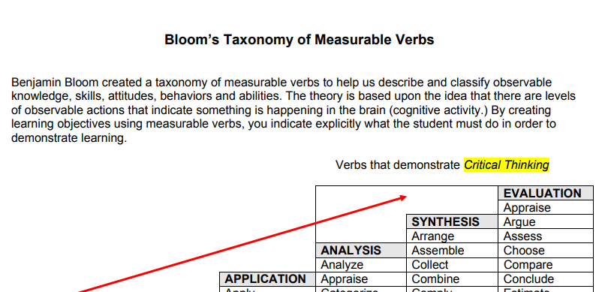
Learning Strategies to Engage Clients
These strategies can be part of your brand!
Consider Learning Objectives
Statement that focus the content creator and the participant to learn a specific skill, technique, or behavior that be understood, practiced, and mastered.
Use them when you organizing your content, meetings, sessions, all communications
Good Vs. Bad Learning Objectives
Bloom's Taxonomy throughout the training design process
Notes:
Learning Strategies to Engage Clients
Consider Learning Objectives
Statement that focus the content creator and the participant to learn a specific skill, technique, or behavior that be understood, practiced, and mastered.
Use them when you organizing your content, meetings, sessions, all communications
Point: With facilitating learning and creating content, you have to know where you want to go in order to confirm you and your learners have gotten there…have learned the content, have demonstrated mastery of skills and behaviors.
Learning objectives help do that.

Slide 8
Final Thoughts – Walk Your Talk
Consider Building Habits
Who do I want to be? Who do your clients want to be?
Explore “who-based” skills and ways of thinking to create habits that give you energy and space for people and opportunities to have the life you want
Wrap Up
Summarize what we covered: Foundations of AD Theory, Learning Strategies, Creating Objectives, a few recommended online learning strategies/format, and concept of habit building.
Notes:
Final Thoughts: Walk Your Talk
Consider Building Habits
Who do I want to be? Who do your clients want to be?
Explore “who-based” skills and ways of thinking to create habits that give you energy and space for people and opportunities to have the life you want
Wrap Up
Summarize what we covered: Foundations of AD Theory, Learning Strategies, Creating Objectives, a few recommended online learning strategies/format, and concept of habit building.
Final discussion question: Based on this session, what is the next step you want to take in creating content or developing your coaching practice?
Questions, additional throughs, pass back to host.

